Slide 1
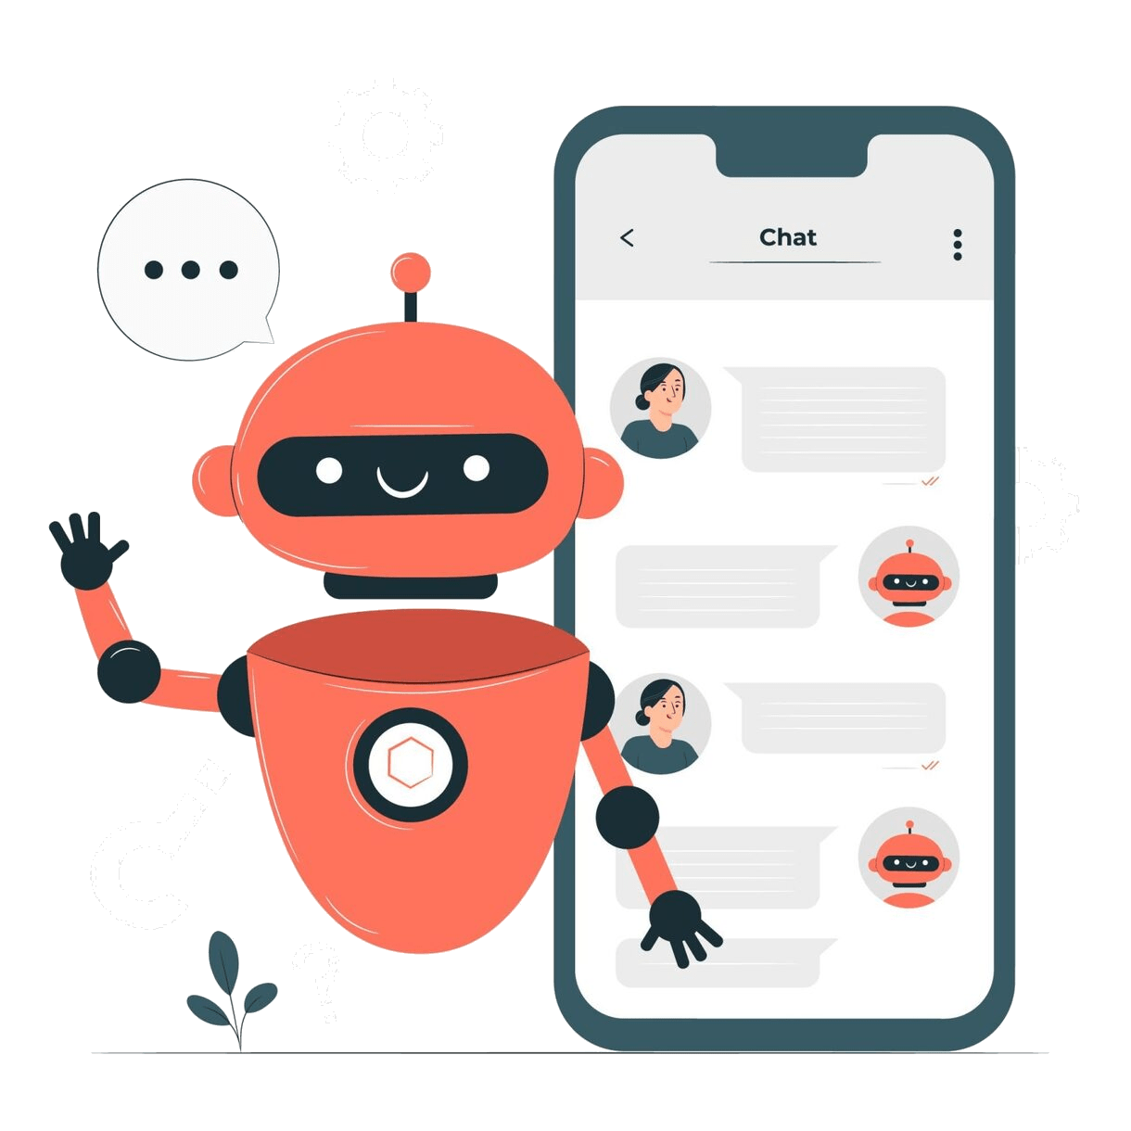
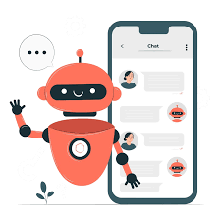
DAYANANDA SAGAR UNIVERSITY
LLM : Chatbot with language translator
Created by Team: Ullas chander R
T.S Farhan
Yogesh N
Mitesh Srinivas

Slide 2
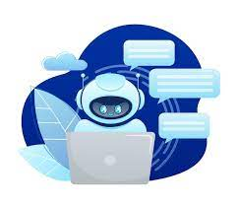
CONTENTS
01
INTRODUCTION
02
DOMAINS
03
PROBLEMS FACED BEFORE
04
IMPLEMENTATION OF CODE
05
RESULT AND ANALYSIS
05
CONCLUSION

Slide 3
INTRODUCTION
A chatbot is a computer program designed to simulate conversation with users, typically through text-based interfaces. These artificial intelligence agents use natural language processing to understand and respond to user inputs, providing information, assistance, or performing tasks in a conversational manner.
Language translation is a vital tool in our interconnected global society, fostering communication and understanding among diverse linguistic communities.The primary goal of language translators is to facilitate seamless communication between people who speak different languages, whether in written or spoken form. These translators can handle a wide range of content, including documents, websites, emails, and real-time conversations. They play a crucial role in various contexts, from international business and diplomacy to everyday interactions between individuals from diverse linguistic backgrounds.

Slide 4
DOMAINS
1. Natural Language Processing (NLP):NLP enables chatbots to understand, interpret, and generate human-like text.
2.Machine Learning (ML):Chatbots use ML for tasks like user behavior analysis, personalized recommendations, and refining their responses based on user interactions.
3.Speech Recognition: Some chatbots incorporate speech recognition technology to understand and process spoken language. This allows users to interact with the chatbot through voice commands or messages.
4. Machine Translation: For chatbots catering to multilingual users, machine translation comes into play. This AI domain helps translate messages between different languages, facilitating communication with users worldwide.
5.Knowledge Representation and Reasoning: Chatbots often utilize knowledge representation techniques to store and manage information.

Slide 5
PROBLEMS FACED BEFORE CHATBOT
1. Limited Automation: Traditional automated systems lacked the ability to handle complex and dynamic conversations.
2.Linear Interaction:This lack of flexibility could lead to frustration and inefficiencies.
3. User Interface Complexity: In some cases, interacting with automated systems required users to navigate through complex menus and interfaces, which could be confusing and time-consuming.
4.Long Response Times:Automated systems often struggled to provide timely and relevant responses.
5.Limited Natural Language Processing:Traditional systems had difficulty understanding natural language, relying on specific commands or keywords. T

Slide 6
ADVANTAGE
Advanced Natural Language Processing (NLP)
Context Awareness
Conversational Interfaces
Conversational Interfaces
Personalization
Ease of Use
Standardization
Integration Capabilities
Overall, the integration of advanced technologies, including artificial intelligence, machine learning, and natural language processing, empowers chatbots to solve the problems associated with traditional automated systems. They bring a more human-like and adaptable approach to interactions, significantly improving the efficiency and user satisfaction in various domains.

Slide 7
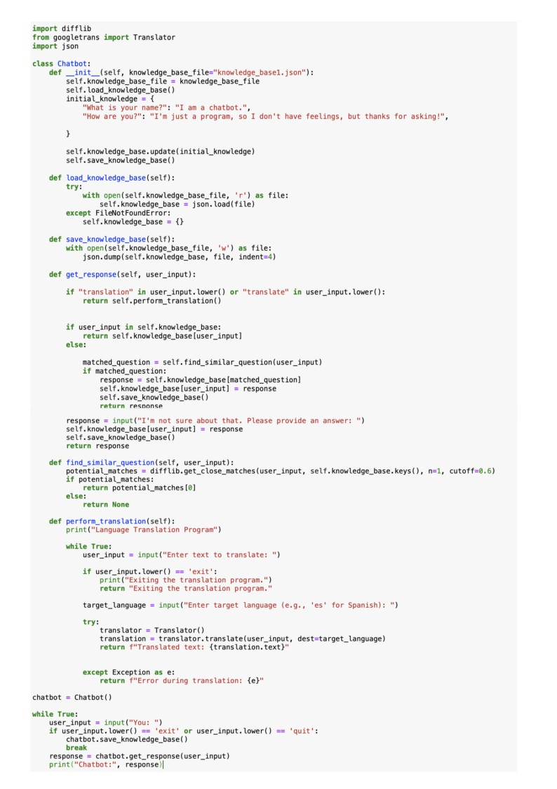
PYTHON CODE

Slide 8
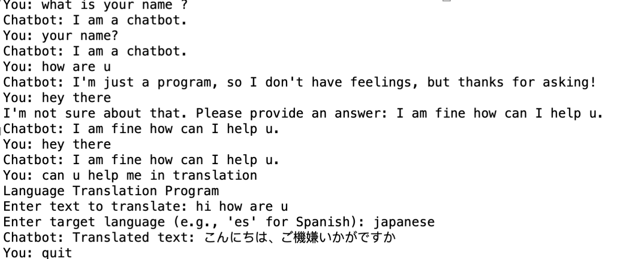
OUTPUT

Slide 9
Conclusion
➢ In conclusion, the development of this project has successfully brought forth a versatile and intelligent chatbot capable of seamlessly addressing user queries and facilitating language translation.
➢Through the integration of advanced natural language processing (NLP) algorithms and translation services, our chatbot has demonstrated its proficiency in understanding and responding to a diverse range of questions in a user-friendly manner.
➢ The incorporation of language translation functionality further extends the reach and usefulness of the chatbot, breaking down communication barriers and fostering cross-cultural interactions.
➢Users can now effortlessly communicate in their preferred language, while the chatbot dynamically translates and responds, enhancing the overall accessibility and inclusivity of the system.

Slide 10



